Slide 1
Processes Lesson 3 Interprocess Communications Examples
David Liu
Fall 2021, Spring 2022

Slide 2
Interprocess Communication Examples
POSIX Shared Memory
Mach Message Passing
Windows Message Passing
Pipes
The Portable Operating System Interface (POSIX, IEEE 1003) is a family of standards specified by the IEEE Computer Society for maintaining compatibility between operating systems

Slide 3
POSIX Shared Memory
Process first creates shared memory segment shm_fd = shm_open(name, O_CREAT | O_RDWR, 0666);
Configure the Size
ftruncate(shm_fd, 4096);
Memory-map a file pointer
ptr = mmap(0, SIZE, PROT_READ, MAP_SHARED, shm_fd, 0)

Slide 4
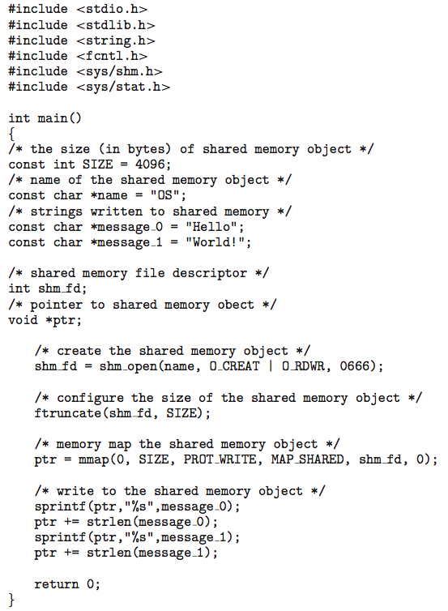
POSIX Producer

Slide 5
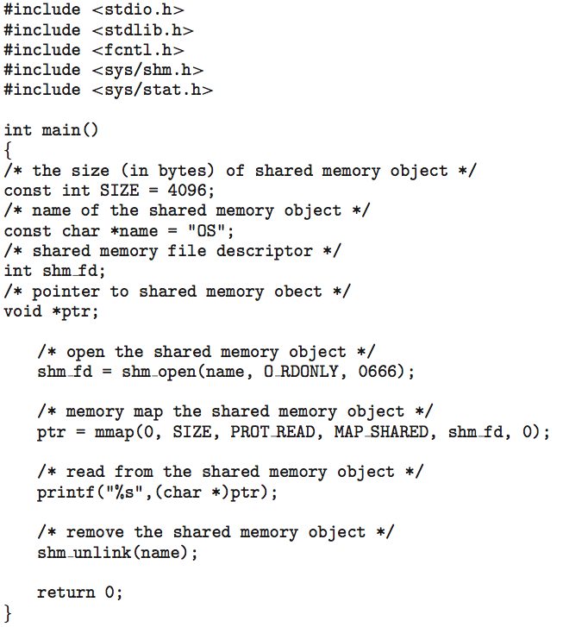
POSIX Consumer

Slide 6
Mach Message Passing
Ports needed for communication, created via
mach_port_allocate(
mach_task_self(,)
MACH_PORT_RIGHT_RECEIVE,
&port)
Send and receive are flexible, for example four options if mailbox full:
Wait indefinitely
Wait at most n milliseconds
Return immediately
Temporarily cache a message
Port rights for each task: MACH_PORT_RIGHT_RECEIVE & MACH_PORT_RIGHT_SEND
Each task starts with two special ports: Task Self and Notify ports

Slide 7
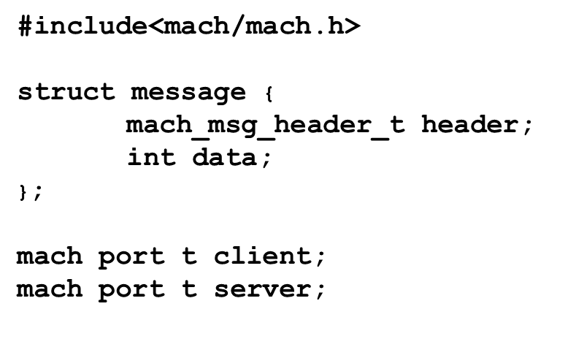
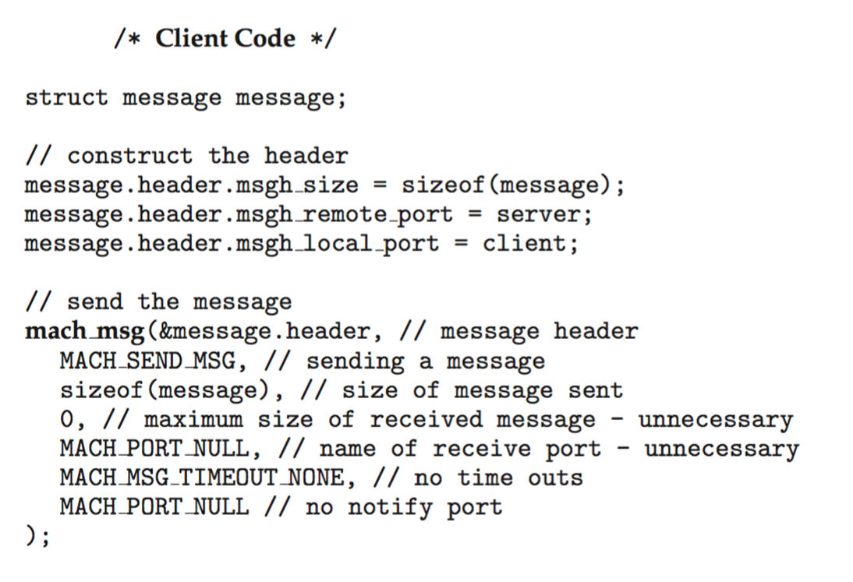
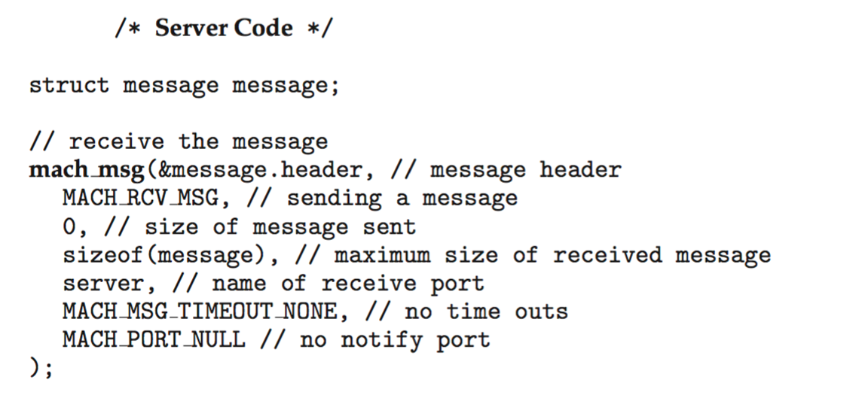
Mach Message Passing

Slide 8
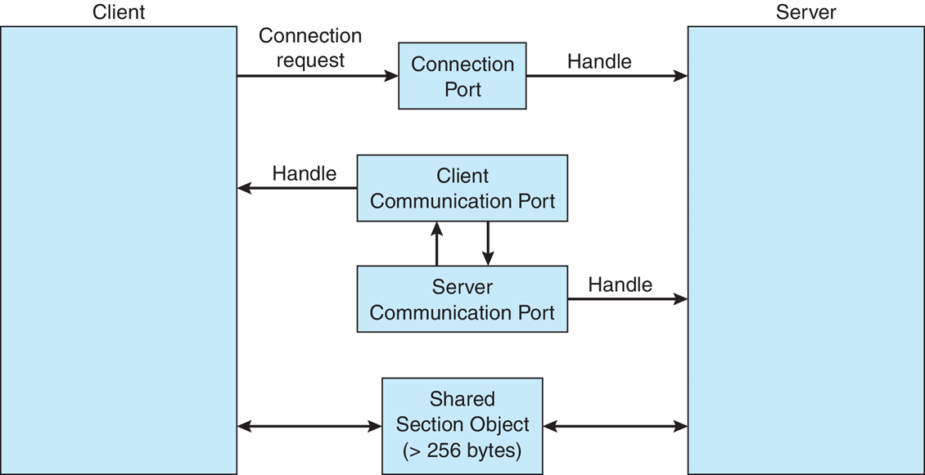
Window Message Passing
On the same system, advanced local procedure call
Client request to Connection port
Server creates: two private communication ports
Message Passing
Port queue
Channel’s section object
Client’s address space

Slide 9
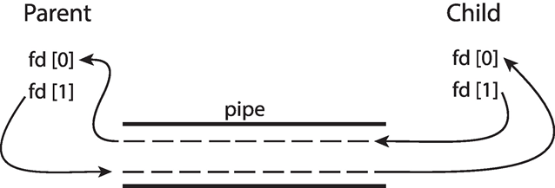
Pipes
Ordinary pipes
Between a parent process and a child process
Child share the special files of pipes
Named Pipes
Any process through pipe name
Several processes

Slide 10
Client-Server Communication
Sockets
Remote Procedure Calls

Slide 11
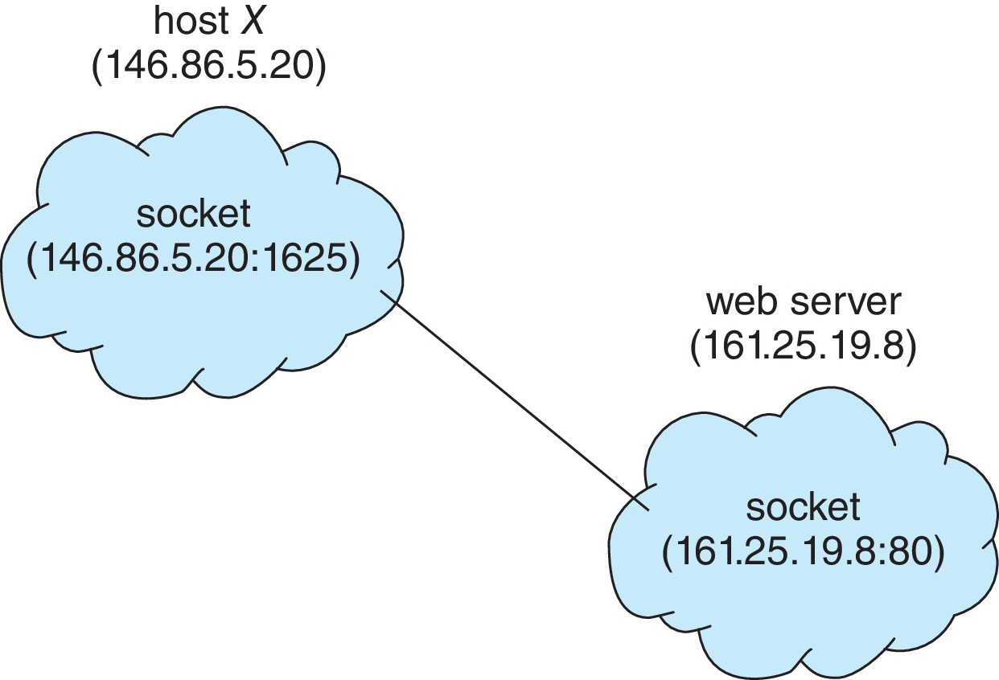
Socket Communication
Three types of sockets
Connection-oriented (TCP)
Connectionless (UDP)
MulticastSocket class– data can be sent to multiple recipients
Special IP address 127.0.0.1 (loopback) to refer to system on which process is running

Slide 12
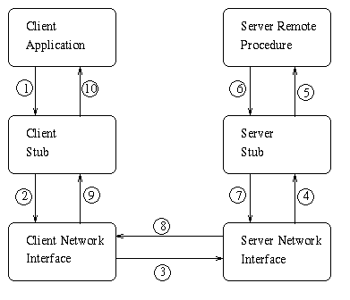
Remote Procedure Call
Semantics: a client to invoke a procedure on a remote host as it would a procedure locally
How to find the remote process?
Matchmaker service on a fixed port
How to pass parameters?
Client and Server Stubs and Marshalling
Communication Failure?
at most once – history info
exact once – ack and resend

Slide 13
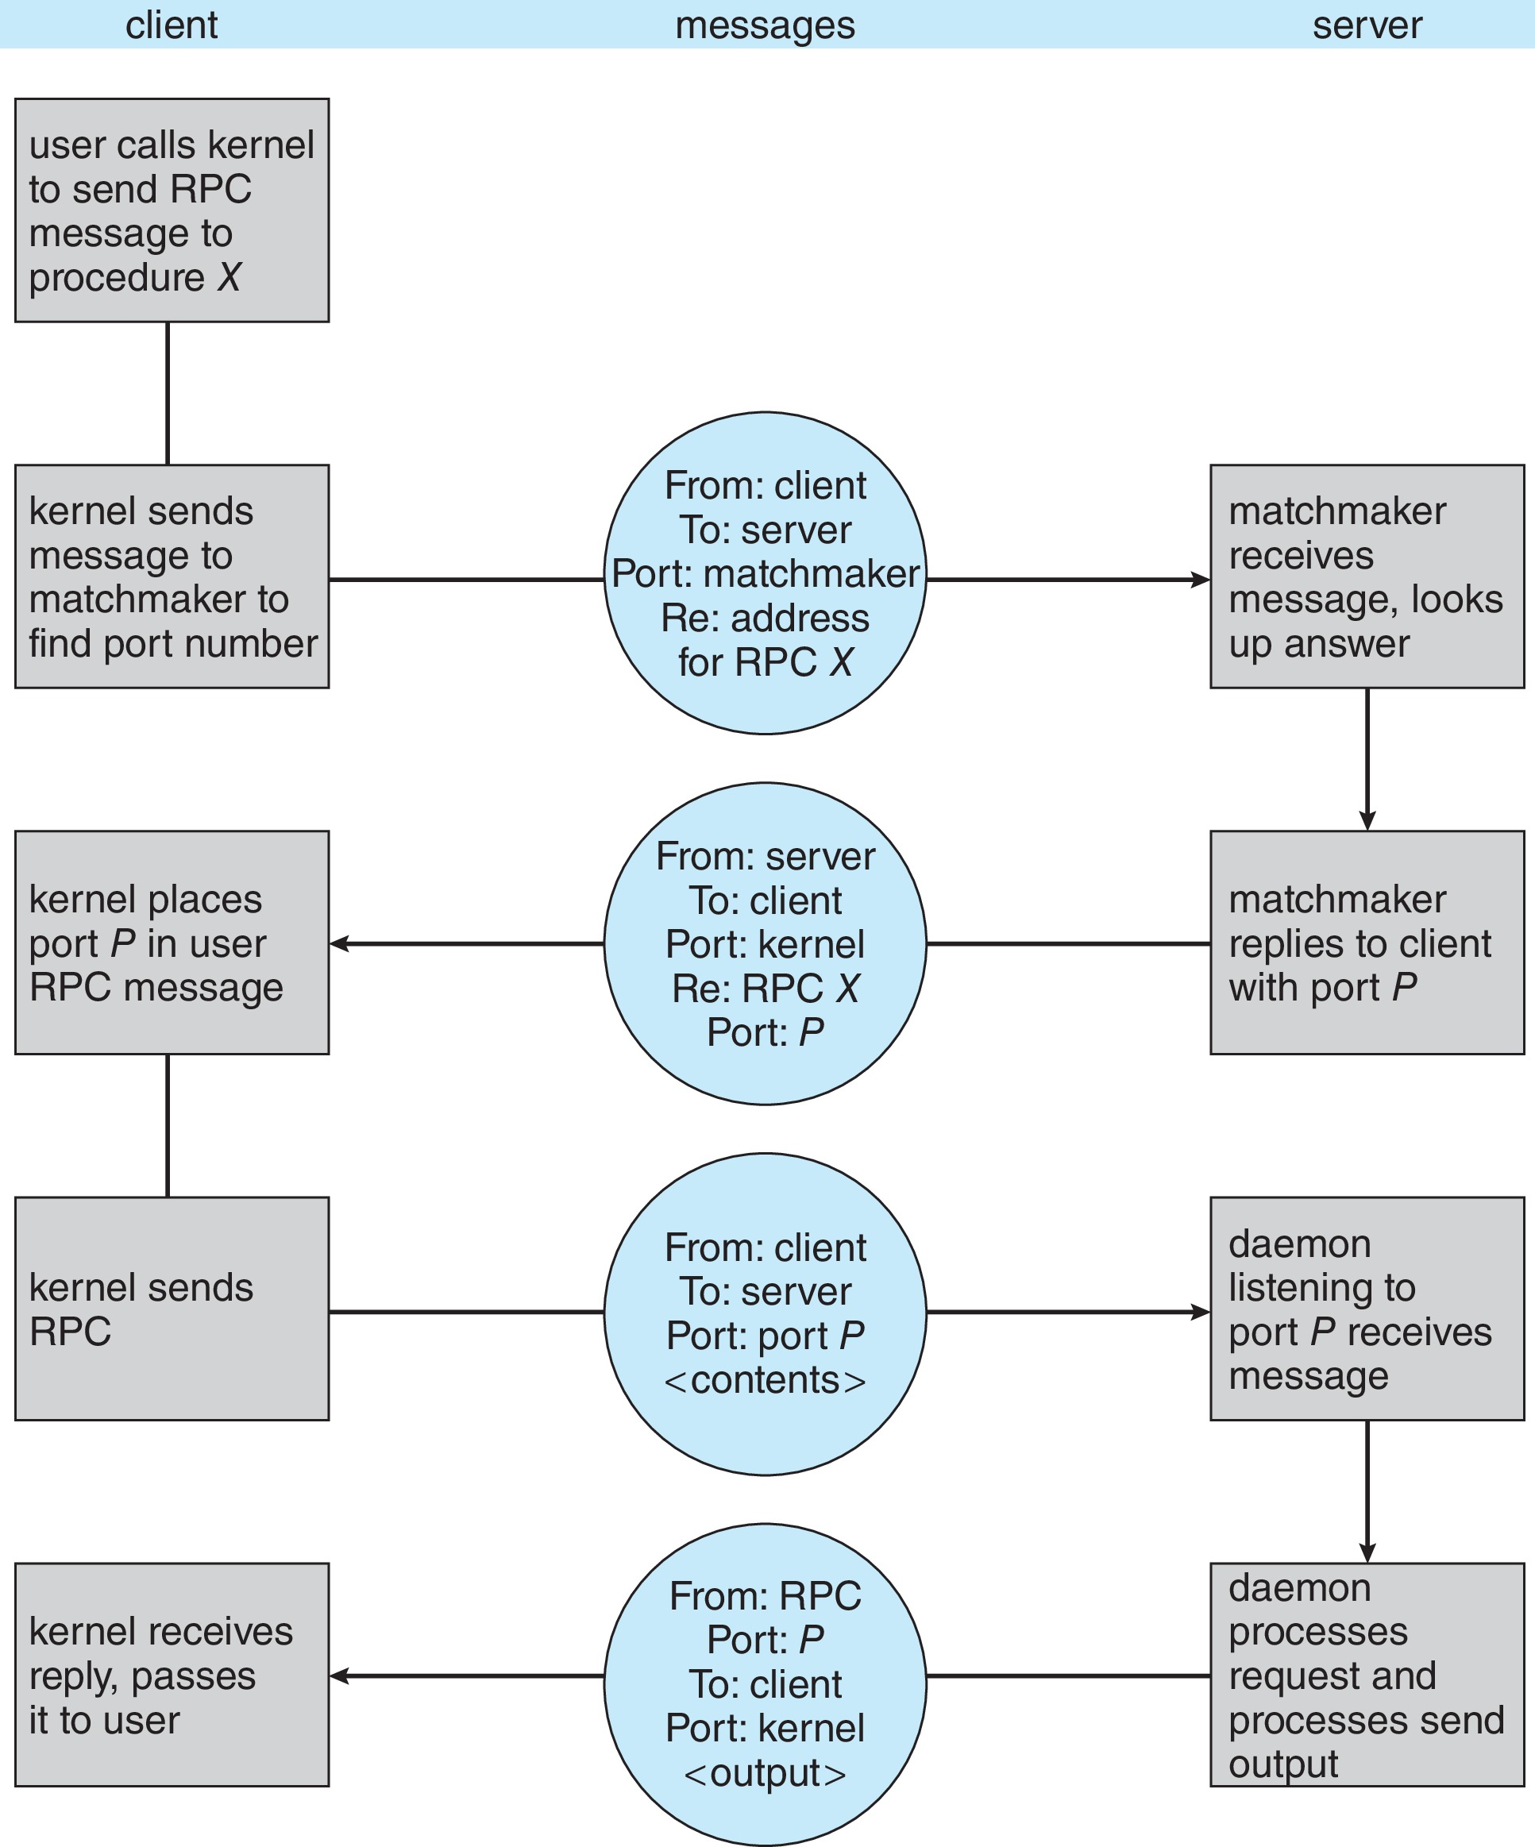
RPC Running

